Slide 1
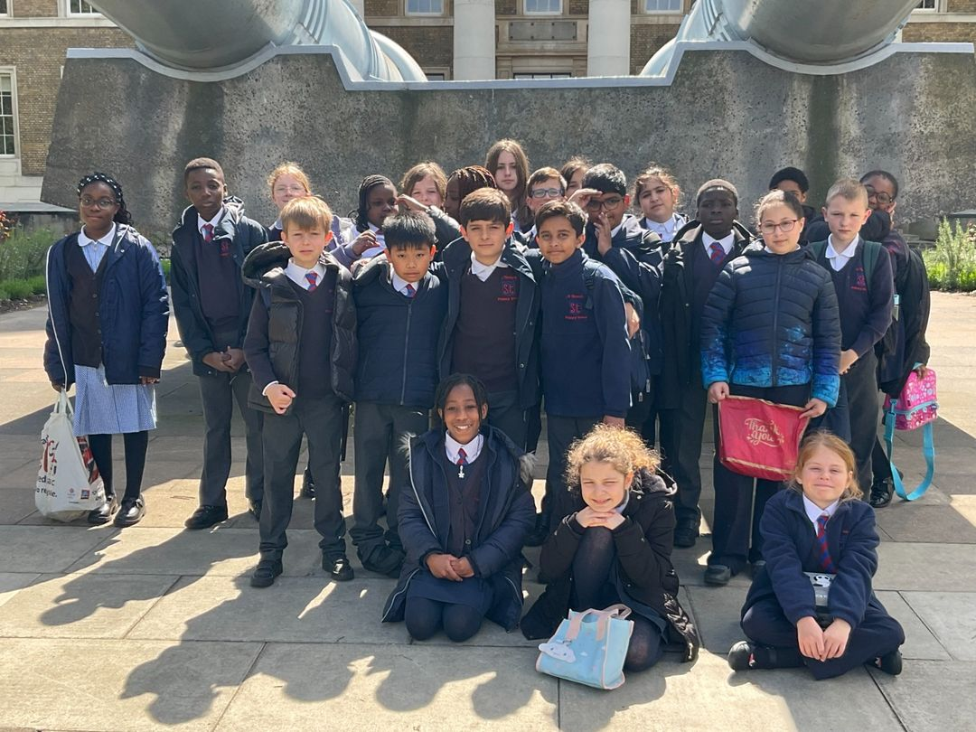
Meeting for Year 6 Parents and Carers
Monday 9th September 2024

Slide 2
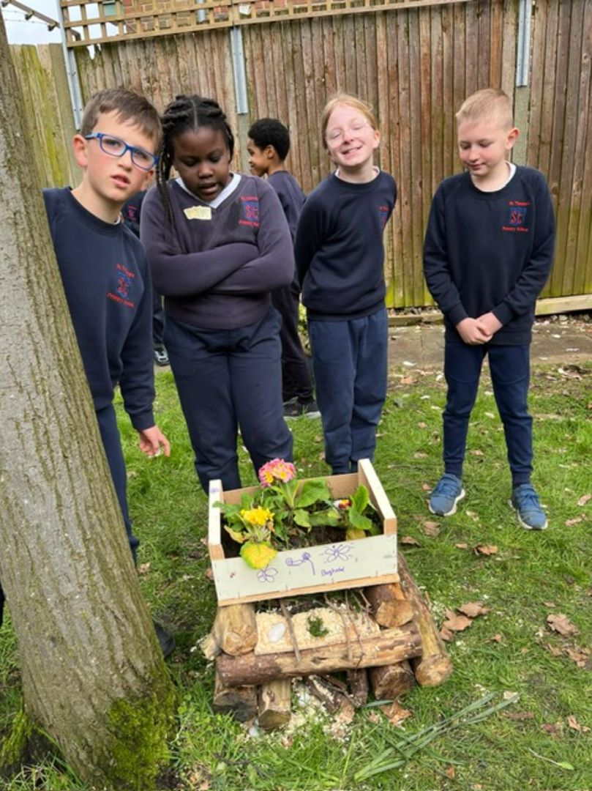
End of Key Stage 2 National Tests
(Key stage 2 is Y3/Y4/Y5/Y6)
The Year 6 pupils will take the tests in the week beginning Monday 12th May 2025.
The tests assess the pupils against the
2014 Key Stage 2 National Curriculum.
A new test and mark scheme is
developed each year.
The Key Stage 2 tests will be marked
by external markers.

Slide 3
Timetable for SATs week
Monday 12th May SPAG (Spelling, grammar and punctuation) | Grammar, spelling and punctuation Paper 1 Spelling Paper 2
Tuesday 13th May Reading | Reading
Wednesday 14th May Maths | Maths Paper 1 Maths Paper 2
Thursday 15th May Maths | Maths Paper 3
NO TEST FOR WRITING

Slide 4
Spelling, Punctuation and Grammar (SPAG)
Monday 12th May Paper 1 - questions 45 minutes (50 marks) For example of paper 1 click here. Monday 12th May Paper 2 - spelling (not timed) (20 marks) For example of paper 2 click here. Total marks 70 In May 2024 a child needed 35 marks out of 70 to meet the standard.

Slide 5
Reading
Tuesday 13th May Single Paper - 1 hour Total marks 50 For example of the Reading Booklet click here. For example of the Reading Answer Booklet click here. In May 2024 a child needed 27 marks out of 50 to meet the standard.

Slide 6
Maths
Wednesday 14th May Paper 1 – Arithmetic 30 minutes 40 marks For example of Paper 1 click here. Wednesday 14th May Paper 2 – Reasoning 40 minutes 35 marks For example of Paper 2 click here. Thursday 15th May Paper 3 – Reasoning 40 minutes 35 marks For example of Paper 3 click here. Total marks 110 In May 2024 a child needed 54 marks out of 110 to meet the standard.

Slide 7
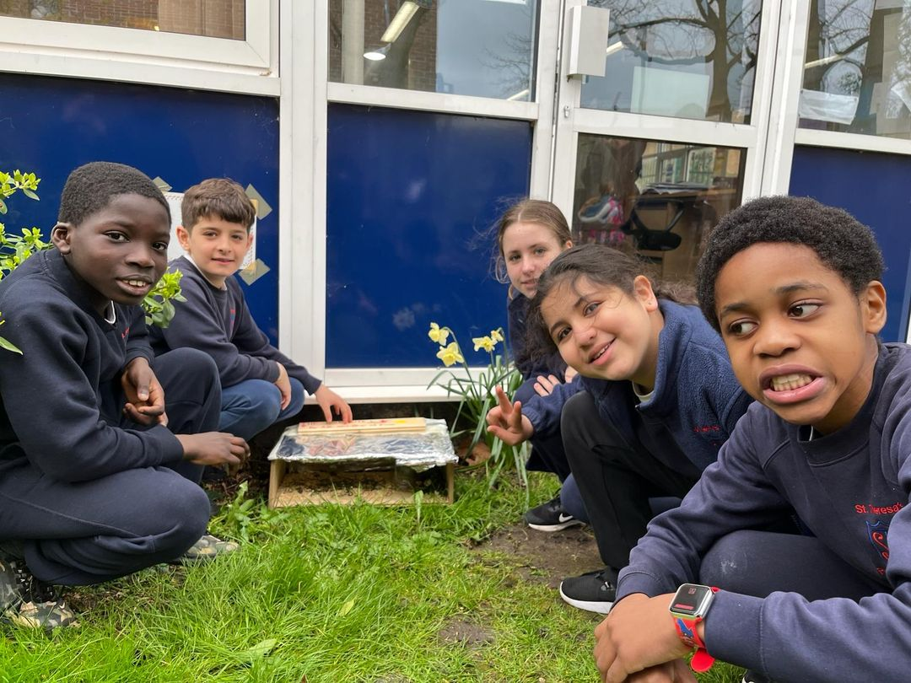
Sample test materials can be found on www.gov.uk

Slide 8
Specific needs
difficulty reading
difficulty writing
difficulty concentrating
processing difficulties
a hearing impairment
A visual impairment
English as an additional language
We will speak to you if we feel your child should be considered for access arrangements. Any additional support should be based primarily on normal classroom practice.

Slide 9
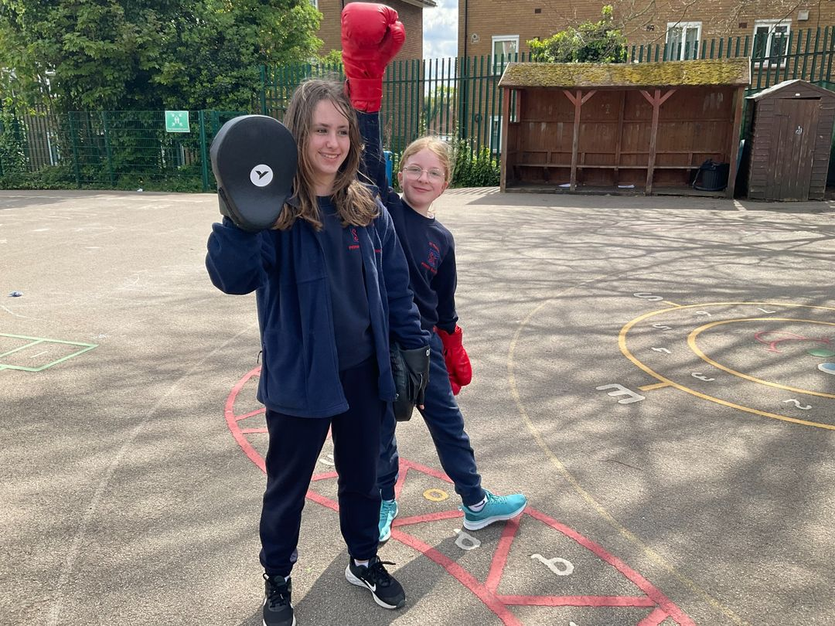
Writing
2025
No writing test.

Slide 10
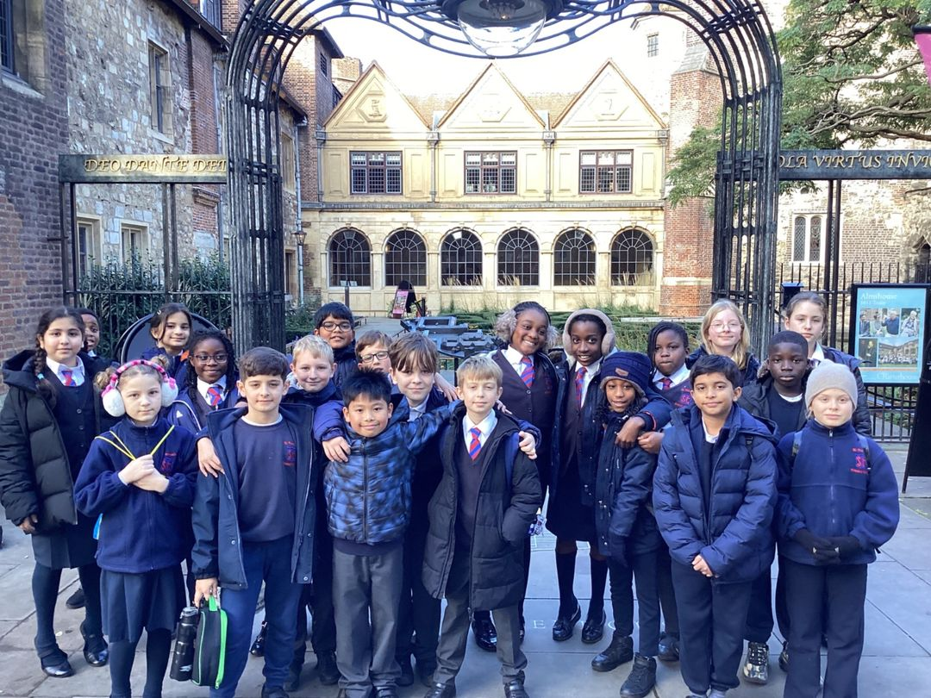
Science
2025
No science test. The school may be selected to complete a Science ‘sampling’ paper. These tests are for sampling purposes only.

Slide 11
2025 key stage 2 test results
To achieve the expected standard a child must achieve a scaled score of 100 or above
Maths | Working at the expected standard Not working at the expected standard | Scaled score of 100 or more Scaled score of less than 100 | Externally set and marked
Reading | Working at the expected standard Not working at the expected standard | Scaled score of 100 or more Scaled score of less than 100 | Externally set and marked
Spelling, Punctuation and Grammar | Working at the expected standard Not working at the expected standard | Scaled score of 100 or more Scaled score of less than 100 | Externally set and marked

Slide 12
2025 key stage 2 teacher assessment
In addition to your child sitting the tests, the school will also need to submit a judgement as to whether your child has met the expected standard in writing and science
Writing | Working at greater depth (above) Working at the expected standard Not working at the expected standard
Science | Working at the expected standard Not working at the expected standard
Examples of Y6 pupils who are achieving the expected standard in writing and for pupils who are achieving greater depth in writing can be found here:
https://www.gov.uk/government/publications/2018-teacher-assessment-exemplification-ks2-english-writing

Slide 13
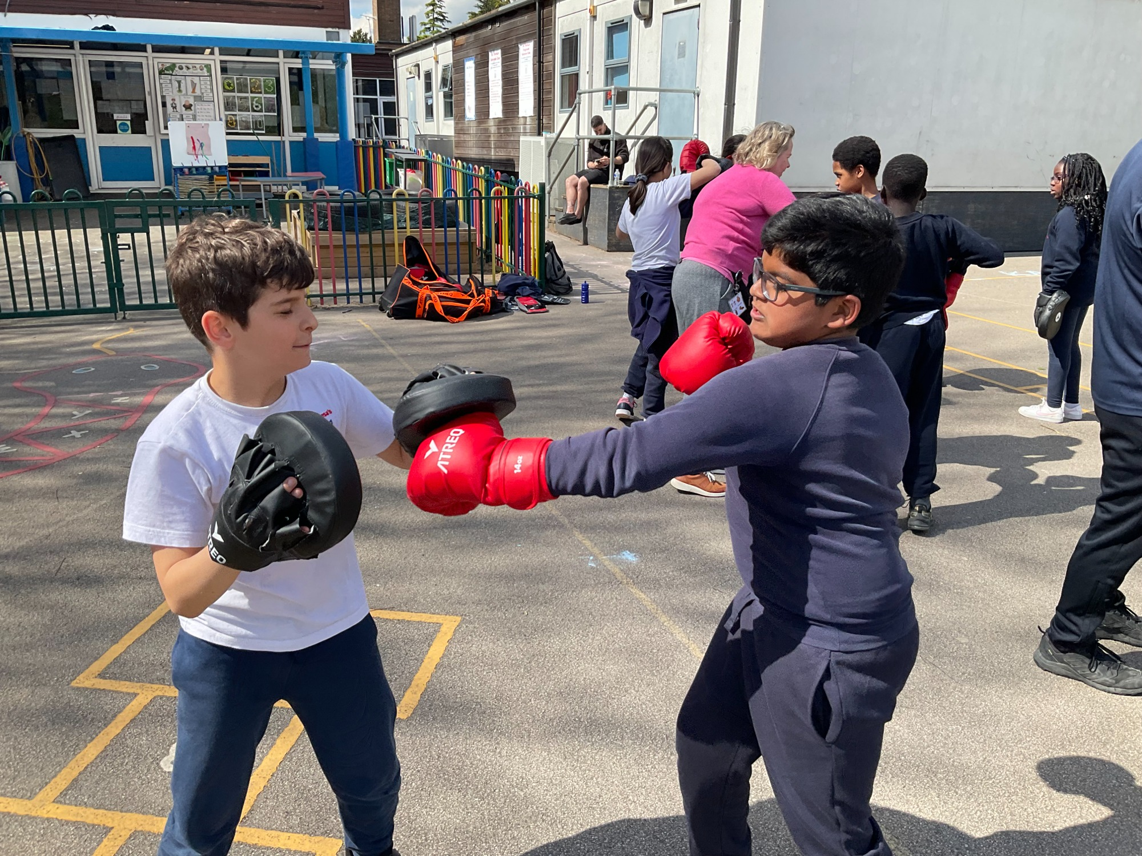
Practice SATs week in school in March 2025.
Your child’s SPAG, READING and MATHS test results, along with the teacher assessment for WRITING and SCIENCE will be sent home to parents in July 2025.

Slide 14
Expectations of Y6 pupils
Highest standards of behaviour
Being on time and ready for lessons
Leadership of younger children
Commitment to their learning (presentation, concentration, effort, resilience)
Commitment to their homework
‘Joining in’ with school life

Slide 15
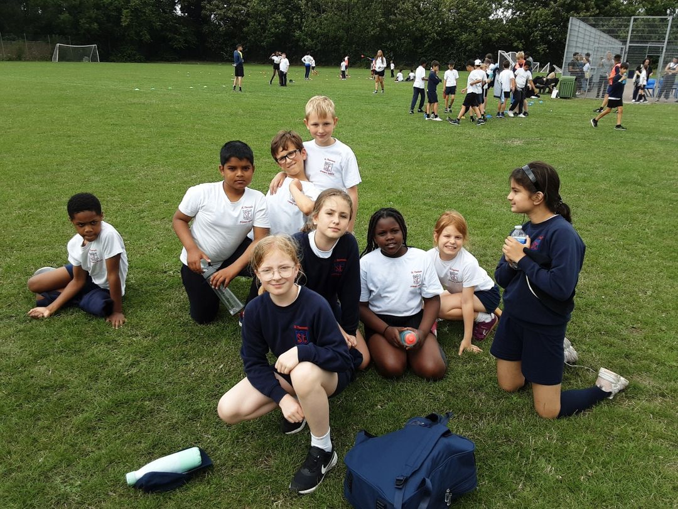
How can parents help?
Encourage their child’s independence
Let them take responsibility for their work and actions
Ensure there is a calm, quiet environment for homework
Ensure that time is organised within the family ‘routine’ for school work
Bedtime routine
Healthy lifestyles
Read every day

